Slide 1
Idea for REDD+ emission reduction Program in Vietnam
Presented at the 6th FCPF Carbon Fund
Washington DC
15-16 March 2013

Slide 2
Overview
Summary of relevant national commitments, strategies and policies on REDD+
Update information on progress of ER-PIN development

Slide 3
Summary of relevant national commitments, strategies and policies on REDD+

Slide 4
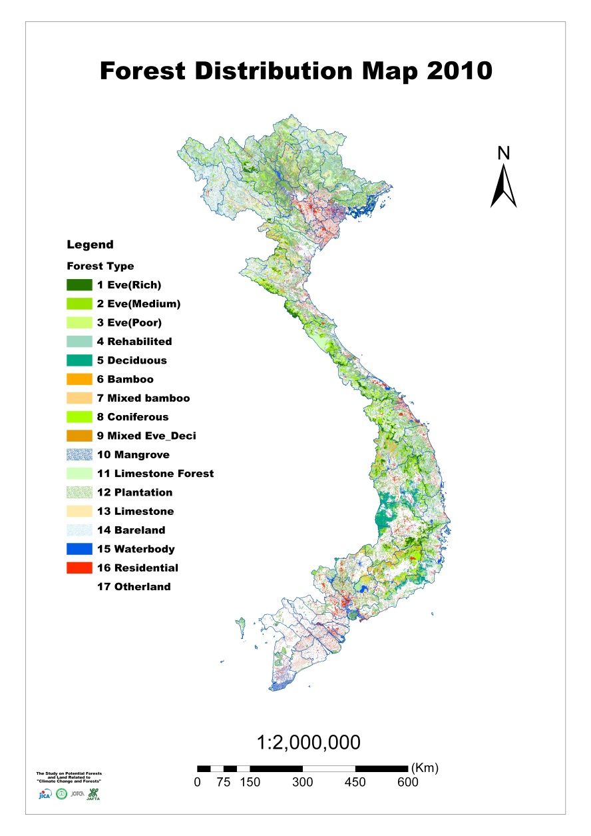
Forests in Vietnam
Total land mass: 33 million Ha, of which ¾ are hills& mountains
Population in 2010: 87 mill, of which 70% lived in rural areas and livelihoods rely on agricultural cultivation
Designated forestland: 16.24 million ha (49% total country land mass)
Notes:
4
The pilot sites are
Cardamoms Mountains (Cambodia/Thailand)
Xe Pian – Dong Hua Sao/Dong Ampham (Lao PDR/Cambodia)
Xishuangbanna (PRC/Myanmar)
Tenasserim in the Western Forest Complex - Kaeng Krachan Complex (Thailand/Myanmar)
Ngoc Linh – Xe Sap Biodiversity Corridor Conservation Project (Viet Nam)

Slide 5
Key national forest policies in last decades
Consistent national policies on forest protection and development since 1990
1992-1997: the “Re-greening barren land and hills” prog.
1998-2011: the “Five million ha reforestation” Prog.
2011-2020: the National Action Plan on FP&D, is aimed to protect, improve quality and use sustainably existing forests, expand forest coverage from 39.5% (2010) to 45% (2020)
National policies on socialization and forestland allocation since 1994
National Policy on Payment for Forest Environmental Services (PFES) since 2008
Notes:
5
The pilot sites are
Cardamoms Mountains (Cambodia/Thailand)
Xe Pian – Dong Hua Sao/Dong Ampham (Lao PDR/Cambodia)
Xishuangbanna (PRC/Myanmar)
Tenasserim in the Western Forest Complex - Kaeng Krachan Complex (Thailand/Myanmar)
Ngoc Linh – Xe Sap Biodiversity Corridor Conservation Project (Viet Nam)

Slide 6
Substantial government investment forest protection and development
USD$ 200 mill. in cadastral mapping of forestland allocation; all forested provinces are covered by topographic maps at scale of 1/10,000
Billion dollars have been invested in forest protection and development since 1990; particularly total investment of about US$2.5 billion, of which
State budget: US$700 mill. (eqv to 29% ). In 2012: $60 mill., 2013: US$ 80 mill.;
Remaining 71% ($18 billion) from private investment, PES, REDD+, ODA.
Notes:
6
The pilot sites are
Cardamoms Mountains (Cambodia/Thailand)
Xe Pian – Dong Hua Sao/Dong Ampham (Lao PDR/Cambodia)
Xishuangbanna (PRC/Myanmar)
Tenasserim in the Western Forest Complex - Kaeng Krachan Complex (Thailand/Myanmar)
Ngoc Linh – Xe Sap Biodiversity Corridor Conservation Project (Viet Nam)

Slide 7
National climate change policies
REDD+ is parts of the national CC policies:
National Target Program on Climate Change - NSCC (Decision 158/QD-TTg of Prime Minister, December 2008);
National Climate Change Strategy (Decision 2139/QD-TTg of Prime Minister dated 05th Dec 2011);
National Strategy on Green Growth - NSGG (Decision 1393/QD-TTg of Prime Minister, September 2012);
National Program on reducing emissions in Agriculture and rural development sector to 2020;

Slide 8
ER targets of National CC Policies
To ensure low-carbon and green development, food & energy security, sustainable development
  2012-2020: all sectors: 8-10% compared to 2010; energy sector: 10-20%;
  2021-2030: reduce GHG emissions from 20-30% compared to BAU;
In agricultural sector: to promote green agricultural development. Every decade: reduce 20% GHG emissions, growth rate 20% and reduction of poverty rate by 20%; forestry activities will contribute to reduce about 19 million tons CO₂e from 2012-2020.
Reducing emission reduction and increase in GHG sequestration will become compulsory requirements for all economic sectors;

Slide 9
What is National Legal Framework for REDD+?
National REDD+ Action Program is approved by Prime Minister dated 27th June 2012 (Decision 799/QD-TTg);
GOAL: The NRAP is aimed to reduce net GHG emissions, to contribute to sustainable forest management, biodiversity conservation, and successful implementation of the NSCC, poverty alleviation and Sustainable Devel.;
OBJECTIVES:
For period from 2012-2015: key elements for national operational REDD+ readiness in place, contribution to protecting existing forests, improvement in forest quality and expansion of forest areas; demonstration activities in at least 8 provinces;
For period from 2016-2020: become REDD+ ready to implement at Nation-wide level; contribute to achievement of 20% GHG emission reduction, increase forest coverage to 45%, biodiversity conservation and improvement in livelihoods of local communities;

Slide 10
Enabling policies for the NRAP implementation
Policies on strengthening forest management and protection (decision 07/QD-TTg in Feb. 2012):
  decentralization, clear mandates of local authorities;
  provision of additional budget for forest protection and payment for participation in forest protection activities;
  co-management of forests and benefit-sharing with local communities;
  strengthening the forest rangers: increase total number of forest rangers to 15.000 people by 2015;
Policy on incentivizing/promoting expansion of commercial forests: decision 66/2011/QD-TTg Feb. 2011;
Policy on PFES (US$60 mill. in 2012) and National Target Program on Rural Development, Poverty Reduction

Slide 11
Update progress on ER-PIN Preparation
Based on:
ER-PIN Template
Comments from previous meeting in late January 2013

Slide 12
Check list (1/2)
No. | Required Sections | Progress
1 | Entity responsible for the management of ER Prog | Done
2 | National REDD+ focal point contact information | Done
3 | Partners and other entities involved | Done
4 | ER Program location and lifetime | Significant progress
5 | Description of activities planned under the ER Prog | Significant progress
6 | Consistency with national REDD+ strategy and governance arrangements | Finalizing
7 | Preliminary assessment of SESA and ESMF/safeguards | Significant progress

Slide 13
Check list (2/2)
No. | Required Sections | Progress
8 | Stakeholder Information Sharing, Consultation, and Participation | Significant progress
9 | Additional Benefits | On-going
10 | Benefit Sharing | On-going
11 | Reference Level and Expected Emission Reductions | Significant progress
12 | Forest Monitoring System | Significant progress
13 | Summary of Progress on REDD+ Readiness | Significant progress
14 | Financing plan | Not started

Slide 14
2.1. Formal establishment of joint working team on ER-PIN development
A core working team is established by MARD, consists of members from different Gov agencies and experts; representatives from independent experts, NGOs, international partners are invited to work contribute their knowledge and comments;
The working team is responsible for taking lead in ER-PIN preparation

Slide 15
2.2. Intensive stakeholders consultations
In last 3 months, intensive consultations on aspects of ER Prog. and REDD+, have been conducted
Topics: from site selection, institutional setting, coordination mechanism, REDD+ activities, FPIC, GRM, ect.
Types of stakeholders: relevant stakeholders at both national and provincial levels are carried not only with national entities but also with international development partners, projects/progs;
Methods: a step-wise and phased approach, starting from information sharing to joint-decision making through workshops & meetings at national and local levels; and inherited from previous consultations for NRAP, R-PP;
Experience: provision of right information, attraction of interest, building the trust & responsibility, fruitful discussions

Slide 16
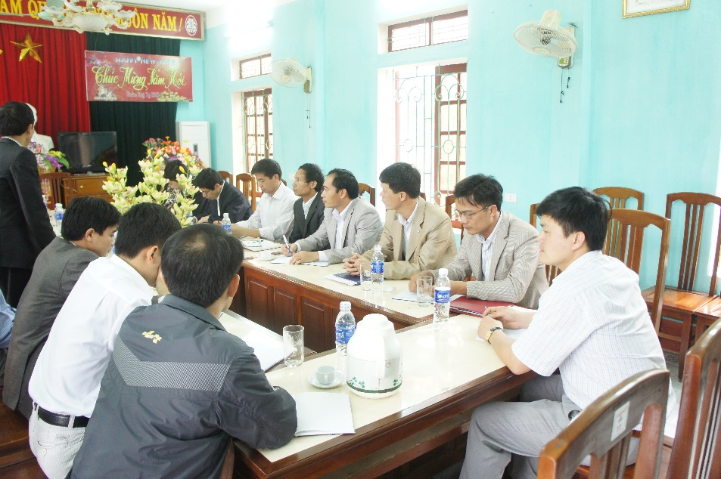
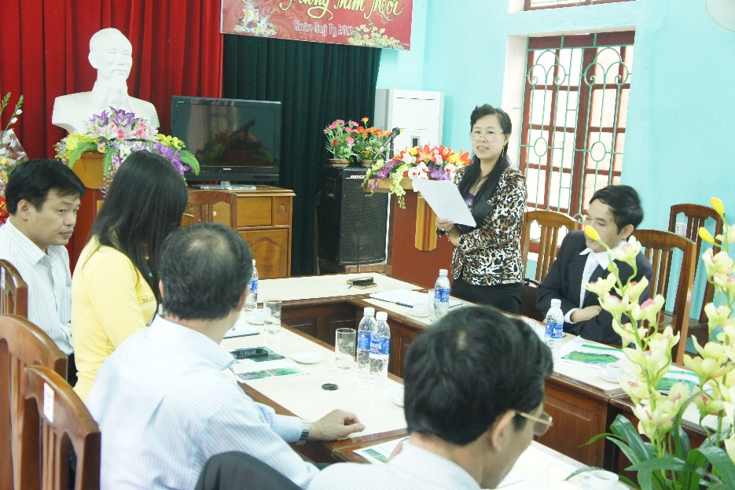
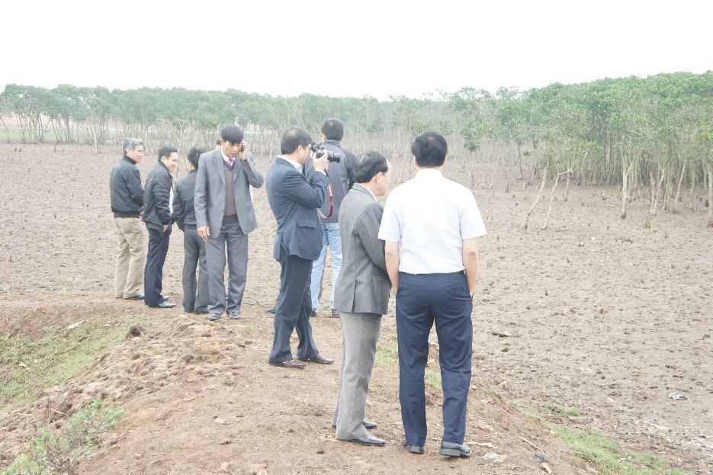
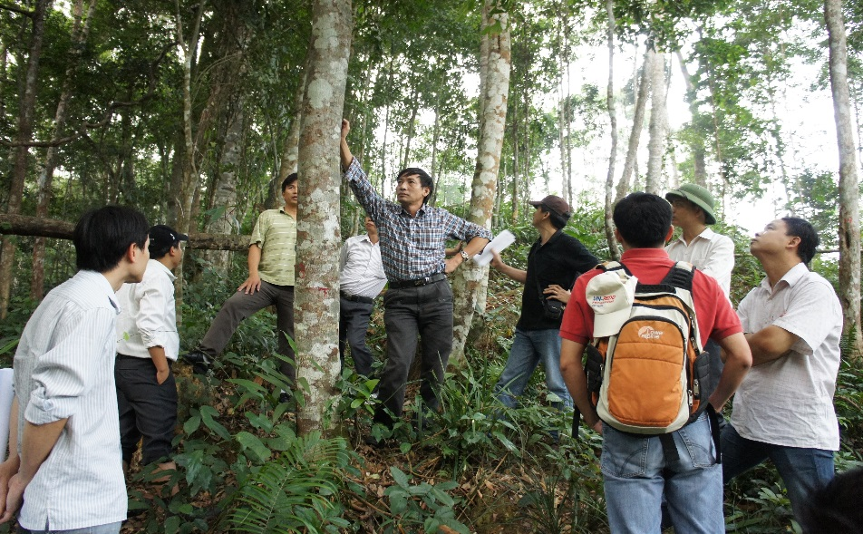
Some consultation events

Slide 17
Results: Interested of participation and commitment
After Awareness raising and consultation events:
Gov shows its commitment by implementation of relevant policies and considerable investment in forestry, agricultural and rural development to address key driving forces behind forest changes, and provide support for REDD+ readiness preparation (regulations, FMS, DBM, BDS);
28 provinces have sent request to attend the ER Program
Participation of NGOs and international development partners. VNFOREST has signed MOUs with ICRAF, RECOFTC, SNV, national NGOs

Slide 18
Consultation on criteria of site selection
Cover large forest areas, high potential of emission reduction;
Commitment of local authorities and capacities of relevant stakeholders;
Opportunities of coordination with on-going policies/programs forest protection, reforestation, climate smart agriculture and livelihood improvement funded by Gov or international partners;
Generate co-benefits (biodiversity conservation, improvement of livelihoods of local communities, promotion of FLEGT/VPA and regional cooperation)

Slide 19
Two options on scale of the ER Program

Slide 20
Scalable options for ER Program
Option 1: only in the Northern Central Coastal Region (3.4 million ha of forestland, of which 2.8 million ha are forested);
Option 2: ER Program will cover 16 provinces with high potential ER (7 mill. ha of forestland). All these provinces have sent letter of interest and commitment to participate in the Program;
The answer is dependent upon the availability of financial resources

Slide 21
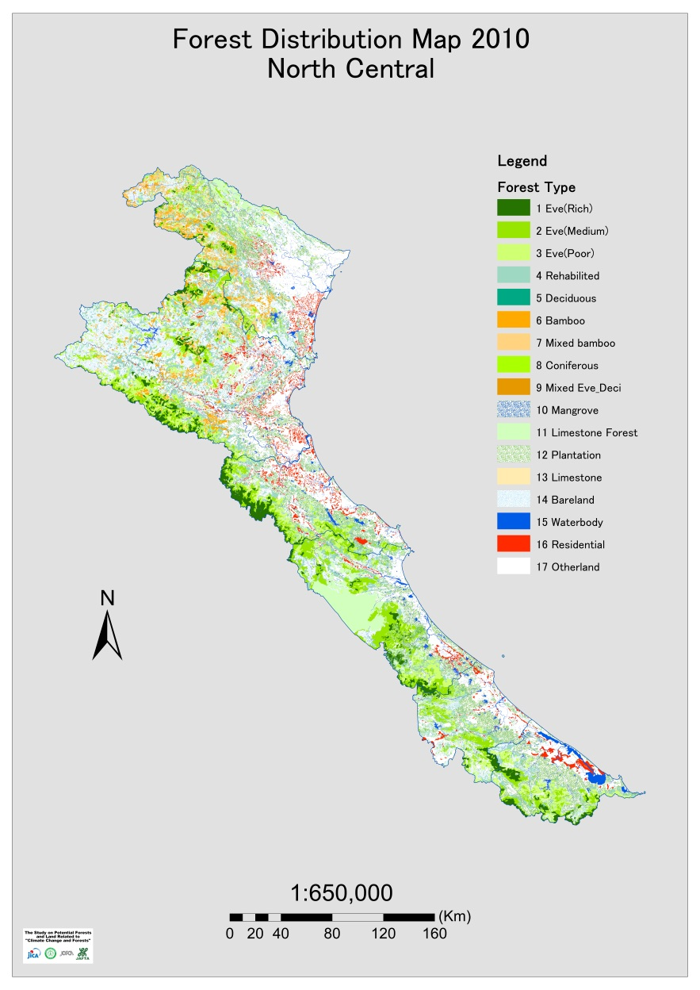
Scale the ER Program: Option 1

Slide 22
Information on the proposed ER site
Province | Total area (ha) | Total forested area (ha) | Natural forests (ha) | Plantations (ha) | Forest cover (%) | Population (1.000 pers)
Thanh Hoa | 1,113,194 | 546,095 | 384,146 | 161,949 | 49% | 3406.8
Nghe An | 1,649,181 | 875,312 | 734,515 | 140,797 | 53% | 2917.4
Ha Tinh | 599,718 | 308,082 | 212,884 | 95,198 | 51% | 1228
Quang Binh | 806,527 | 540,118 | 456,537 | 83,581 | 67% | 849.3
Quang Tri | 473,982 | 223,350 | 138,807 | 84,543 | 47% | 600.5
T.Thien Hue | 503,321 | 285,347 | 202,647 | 82,701 | 57% | 1090.9
Total | 5,145,923 | 2,778,304 | 2,129,536 | 648,769 | 54% | 10,092.90

Slide 23
Discussions on approach and key REDD+ Activities
Reducing emissions by carrying out relevant activities and measures to protect and use sustainably the existing forests, to improve forest quality and to expand forests into non-forested areas.
Landscape-based approach: not only activities within the forestry sector, agricultural and other sector will be taken into account to deliver comprehensive, effective packages for substantial and permanent ER;
Multi-policies and activities will be taken place to effectively address key driving forces behind deforestation and forest degradation, and to accelerate reforestation. It is not wise and practical if only a single REDD+ activity is conducted in a forest stand;
Mobilization of resources from different sources (GoV budget, private sectors, ODA, contribution of local stakeholders)

Slide 24
How to do?
Foundations: NCCS, NGGS, NRAP, NAP on FPD
Development the ER Prog.
Each province will develop its REDD+ Action Plan (RAP); REDD+ activities should be mainstreamed into provincial Socio-economic and Environment Development Master Plan, and consistent with National REDD+ Action Program;

Slide 25
Discussions on Institutional arrangement for ER Prog.
How the ER program will be implemented in line with NRAP and other national policies?
REDD+ = cross-sectors and multi-policies – should not create a totally new institutional arrangement, particularly at local levels; should use the existing institutional system for implementation of National Action Plan on forest protection and development;
Provincial REDD+ Steering Committee (PRSC) of 4/6 provinces are established with early support from GIZ and other partners

Slide 26
National policy-making level
National REDD+ Steering Committee
NC on Climate Chang;
MARD & line Ministries
VNFOREST
Supervision, & Coordination
Vietnam REDD+ Office
Supporting Entities
Universities & research institutions
National REDD+ Network
Sub-Technical working groups
International supported projects/Progs.
Consulting agencies, independent experts
Provincial REDD+ Steering Committee
District and Commune REDD+ Taskforce
Management at local levels
Implementing level
Forest managers and local communities/other stakeholders

Slide 27
Fruitful discussions on cooperation with other REDD+ initiatives/progs
  UN-REDD Phase II: technical building & demonstration REDD+ activities in 6 pilot provinces of which 3 provinces are located in proposed ER Prog.’s site;
  USAID: the Vietnam Forests and Delta Prog. And the Lowering Emissions from Asia Forests (LEAF)
  GIZ, Kfw, BMU: SFM & co-management of forests, reforestation &CO₂ sequestration, technical capacity building, safeguards), SFE reform
  EU: Climate Smart Agriculture
  WB: supports for smallholder plantations in 3 provinces from 2012-2015, US$ 30 million; rehabilitation of mangrove forests

Slide 28
2.3 Continuation of development of interim REL/FRL
Historical NFI data for 5 time points: 1990, 1995, 2000, 2005 and 2010 was improved by using RS imagery and data screening with support from JICA and Finland;
Interim REL for the proposed option 1 is developed based on the improved NFI data (used the national databases);
However, the interim REL should be be refined by using improved data and methodology, and required technical and financial support;

Slide 29
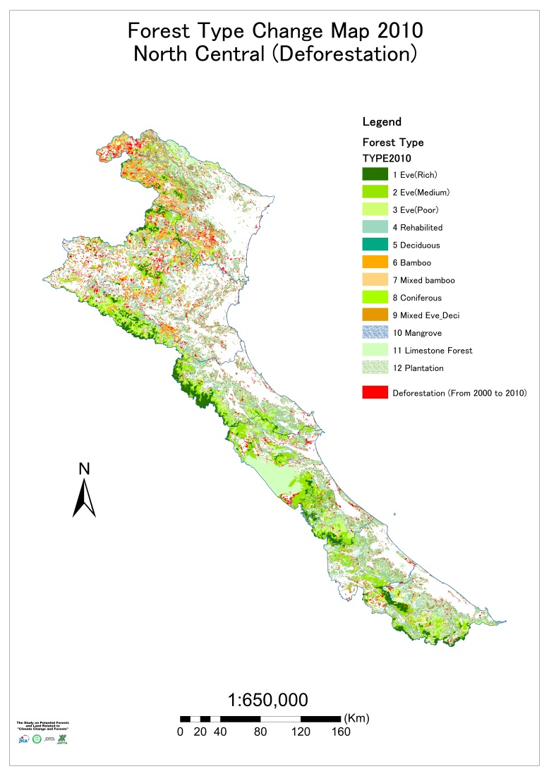
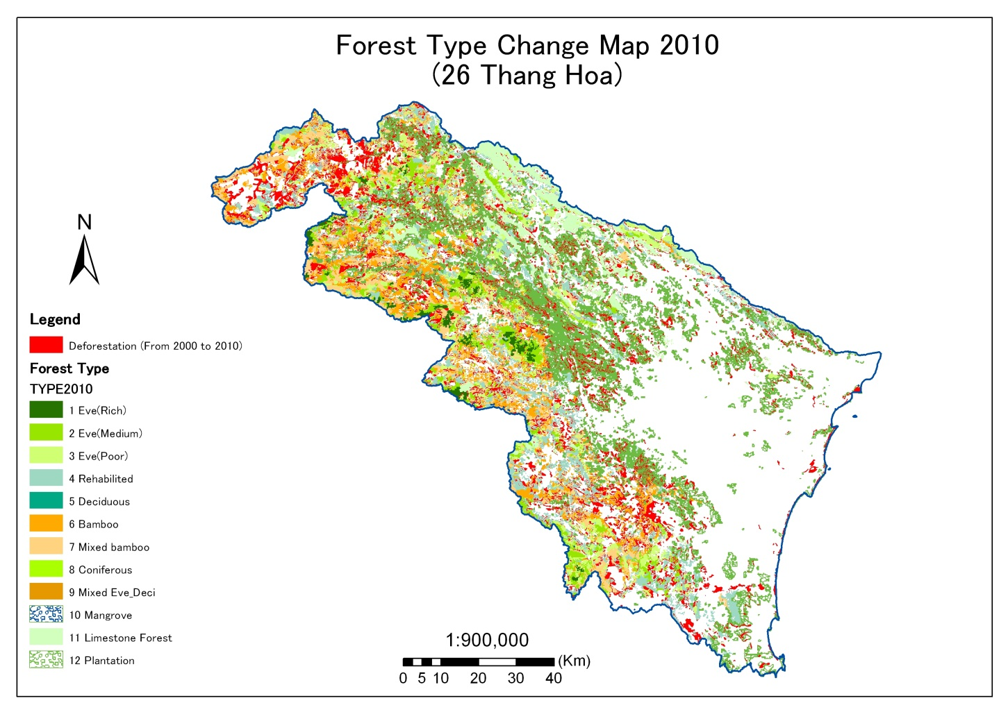
2.4 Analysis of forest changes and key driving forces 1991-2010, measures

Slide 30
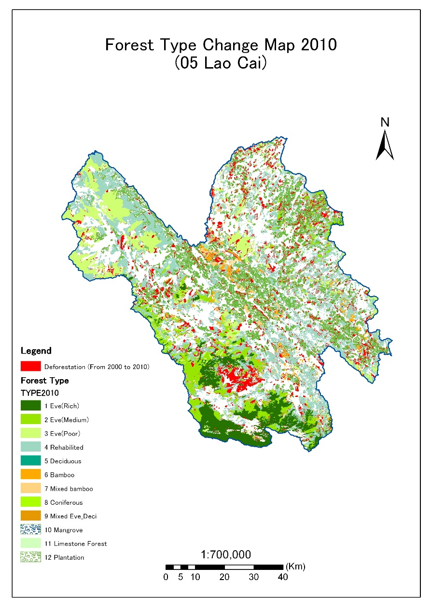
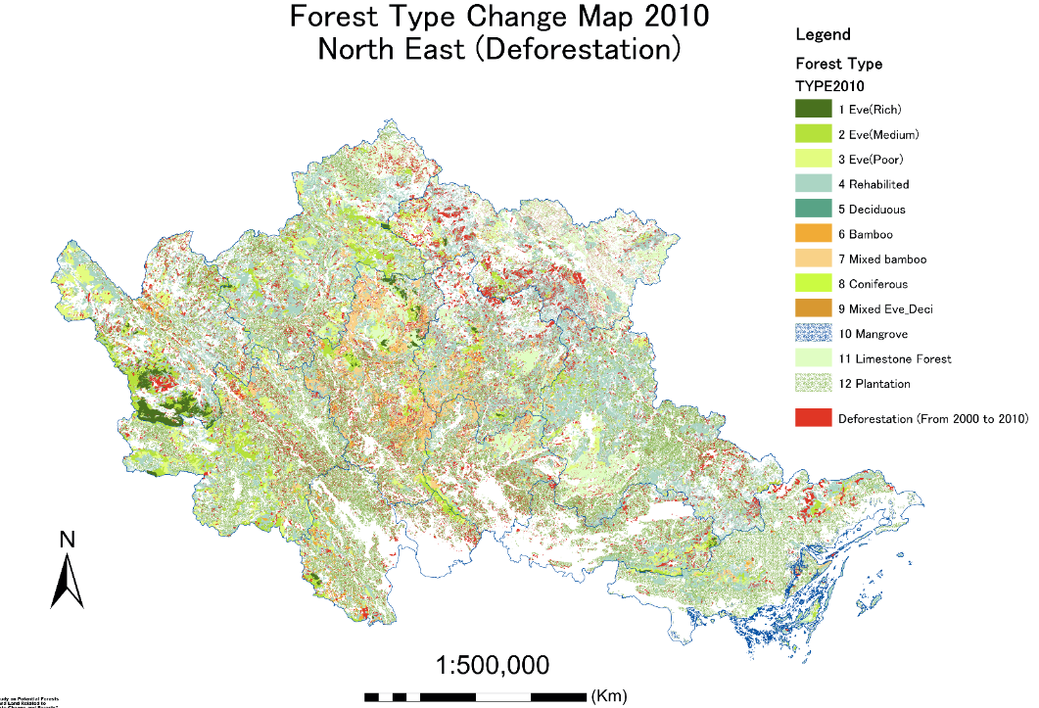
2.4 Analysis of forest changes and key driving forces 1991-2010, measures

Slide 31
2.5 Design the MRV Framework
National REDD+ Information System
National Forest Monitoring System
Monitoring of
Forest resources,
REDD+ implementation
LMS
EF (NFI)
GHG-I
Information on safeguards
M
M(RV)

Slide 32
Continue to design the FMS
Work with FAO, BMU/SNV & RS data suppliers on improving the methods, parameters/indicators and producing demonstrations
  Agreed that parameters should be simple and practical, close linkages with result-based indicators
  Application of remote sensing imagery (high to very high-resolution) to make wall-to-wall forest/land use mapping
  Continue to test and develop detailed guidelines on Participatory monitoring
Completed the improved forest monitoring methods in Ha Tinh provinces which was invested by government budget

Slide 33
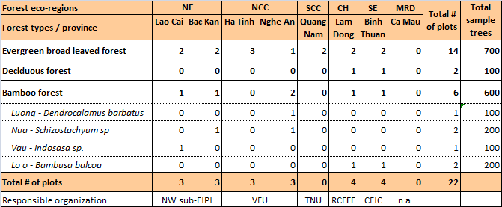
Finalization of development of Emission Factor (EF) & Manuals
    Development of Destructive measurement for Allometric Equations for KEY natural forest types and major species for plantations); Report and database of AE is available at www.vietnam-redd.org/

Slide 34
2.6 Development of policies on transparent and effective data management
Data management and data sharing: completed pilot work in Thanh Hoa province and to develop National Forest Monitoring and Information System (FORMIS) - the project proposal is approved
Started to design a policy on development of registry system for mitigation projects

Slide 35
2.7 Designing mechanisms to address safeguards (1/2)
Recruited team of 2 international experts and 2 national specialist to:
Review current policies and instruments in comparison with Safeguards in the Cancun Agreement and WB regulations
Then, define the roadmap for addressing safeguards, and
Propose a sets of indicators, policies
Work with UN-REDD and FCPF to develop national manual for FPIC;
Organization of sub-technical working group meetings on Safeguards

Slide 36
2.7 Designing mechanisms to address safeguards (2/2)
Grievance Redress Mechanism (GRM): a) a complaint mechanism, b) Laws on Complains and Denouncement
Assurance of carbon rights and forestland tenure rights
Hired an legal specialist to review all government regulations on carbon rights to identify the gaps and actions
Reviewed status of forestland allocation and tenure in the proposed areas
Discussed with UN-REDD Phase II and USAID-funded VFD to provide support on improving forestland tenure rights

Slide 37
2.6 Development of information system on safeguards and its guidelines
Recruited team of 2 international experts and 2 national specialist to:
Review current policies and instruments in comparison with Safeguards in the Cancun Agreement and WB regulations
Then, define the roadmap for addressing safeguards, and
Propose a sets of indicators, policies
Work with UN-REDD and FCPF to develop manuals for FPIC;
Organization of sub-technical working group meetings on Safeguards
Grievance Redress Mechanism (GRM): a) a complaint mechanism, b) Laws on Complains and Denouncement

Slide 38
2.7 Designing BDS
National REDD+ Fund is proposed to be designed for managing and distributing revenue from REDD+ regardless from FCPF ER, UN-REDD or other Progs/Projects
Payment for REDD+ should be incorporated with payment for PES and other inventive progs to ensure that the payment will be based on ER performance to ensure transparency and equity, and avoid double payments;
Organized two national consultation workshops on designing BDS;
The proposal on establishment of National REDD+ Fund is submitted to MARD;

Slide 39
Next Steps
Plan for submission of ER-PIN: Sept. for CF meeting in October 2013
Plan for March – June:
Finalization of selection of ER Prog scale of location
Selection of activities under the ER Prog
Continue to address safeguards requirements
Continue to develop FMS options and estimate expected emission reductions under the ER Prog
Continue the stakeholder consultations on above activities; consultation for full ER-PIN will be done from late July 2013
Continue to work with other international partners to cooperate in the ER prog site

Slide 40
Relationship between Readiness grant and ER program
What is relationship between the FCPF Readiness Grant, UN-REDD and other REDD+ projects, and the ER Progs?
To provide support for National REDD+ Action Program (NRAP), particularly the REDD+ readiness preparation (R-package)
To support for providing inputs for development of ER-PIN
To provide support for implementation of policies, activities that contribute obtain objectives of ER Program

Slide 41
Thank you very much for kind attention!

